Slide 1
Customer segmentation analysis
Loan approval Segmentation
SUBMITTED To: -
Samanta Rana
SUBMITTED By: -
Manish Kataria (W0865937)
Sahil (W0861930)
Parbhjot Kaur (W0859954)
Janvi (W0861408)

Slide 2
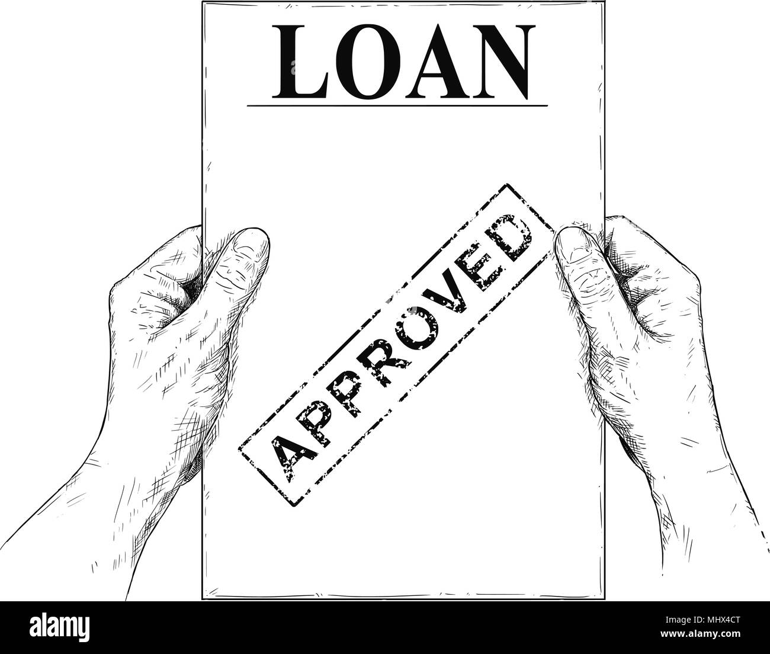
Contents
Introduction
Aim
Exploratory Data Analysis (EDA)
Objective
Target Audience
Structure of the Model
Model and Calculator
Customer Testimonial
Benefits of the System
Conclusion
References
[4]

Slide 3
Introduction
5Ws
What
Why
Who
When
Where
- Customer segmentation in loan approvals categorizes applicants based on their likelihood of given information.
- To identify high-risk and low-risk applicants.
- Banks, financial institutions, credit unions, and fintech platforms.
- A customer submits a loan application.
- Loan applications is process.

Slide 4

Aim
To preform customer segmentation analysis by develop an AI-powered Loan Approval System that automates and optimizes the decision-making process, ensuring accurate, fair, and efficient loan approvals for customers.
[5]

Slide 5
Data Information
Kaggle Based Dataset Loan Default Dataset [1]
In this dataset we have total 255347 entities in 18 variables
EDA
Loan Details
Loan Amount
Interest Rate
Loan Term
Loan Purpose
Demographic Data
Age
Education
Marital Status
Employment Type
Financial Data
Income
Credit Score
DTI Ratio(debt-to-income ratio )
Has Mortgage
Outcome Variable
Default (0/1) (Not approved/approved).

Slide 6

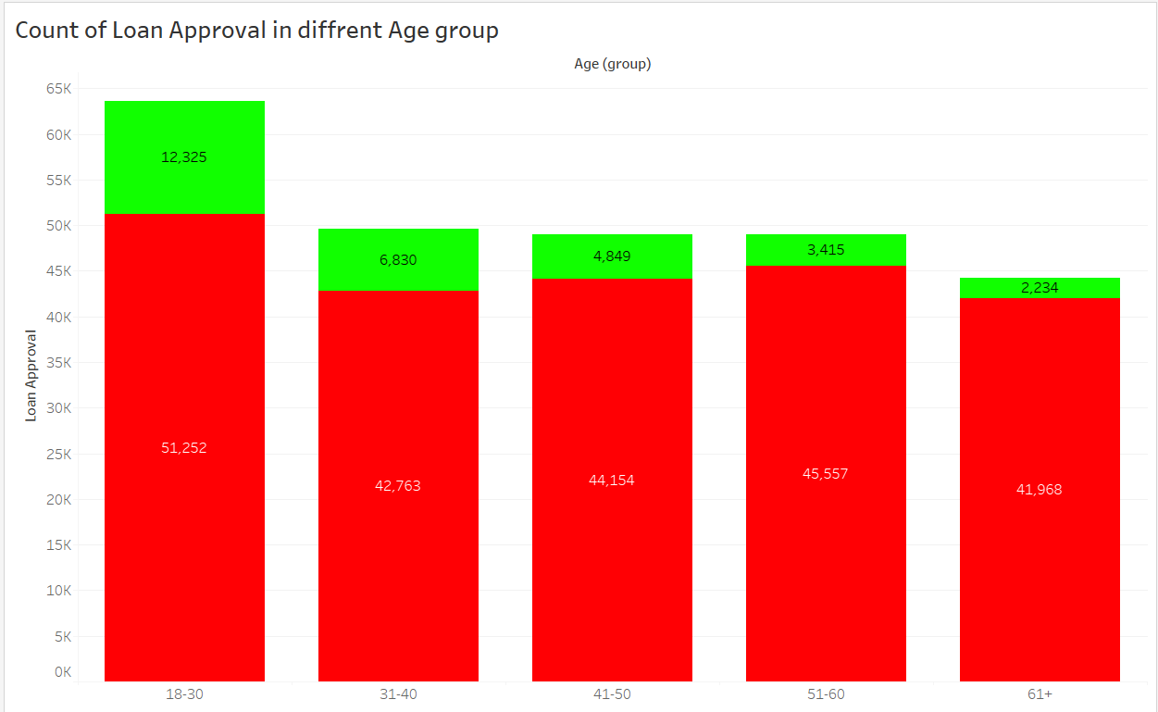
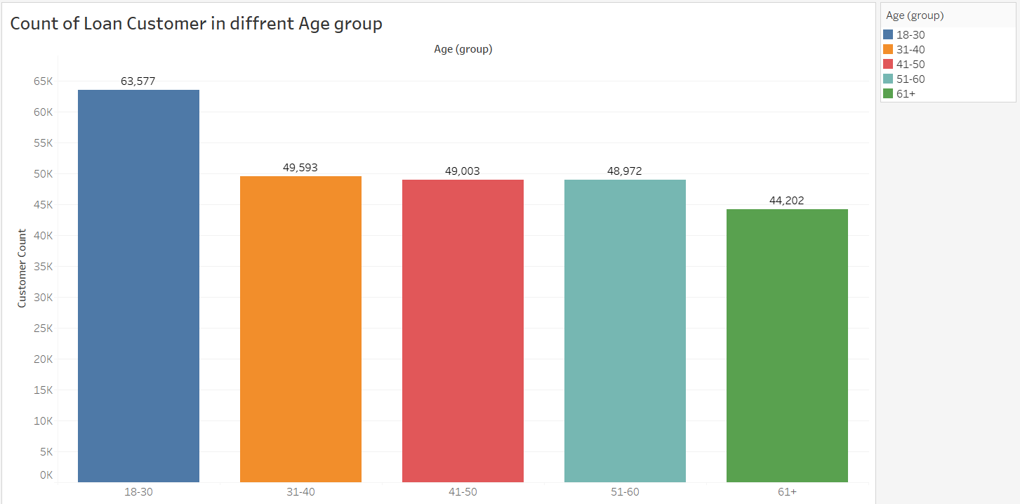
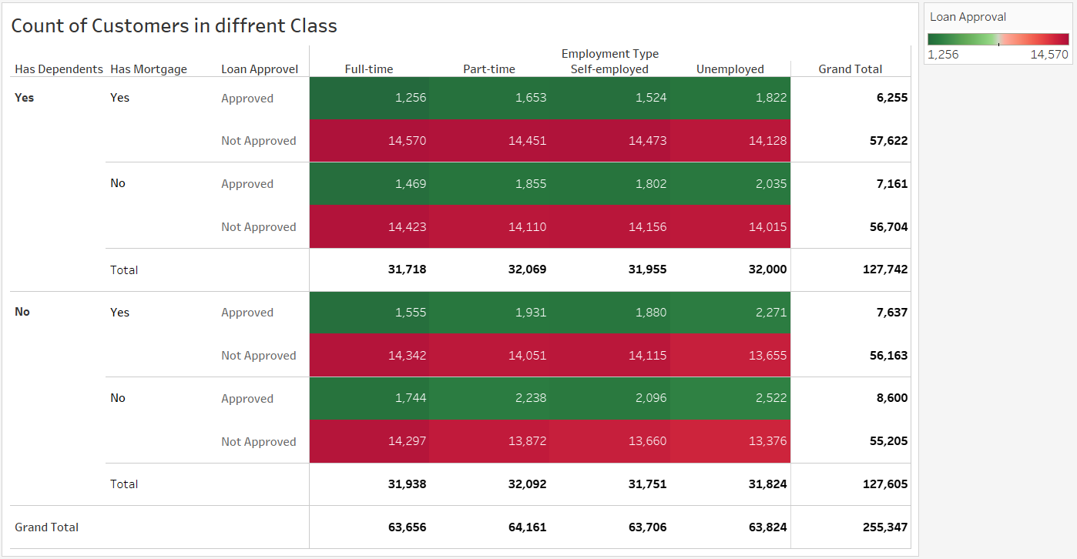
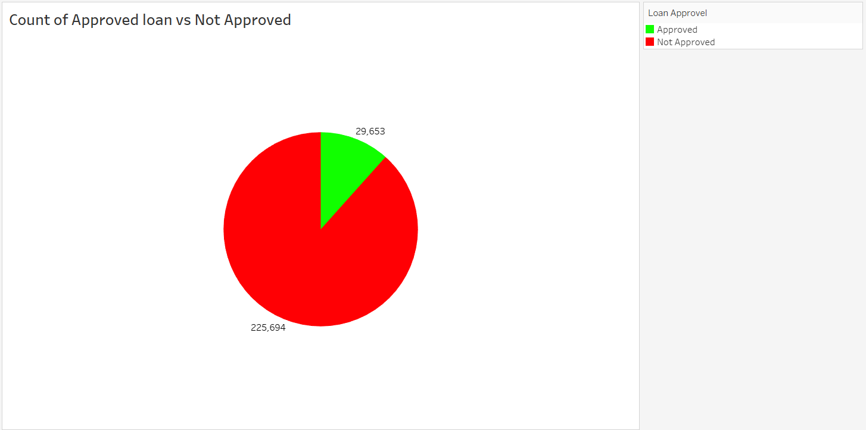
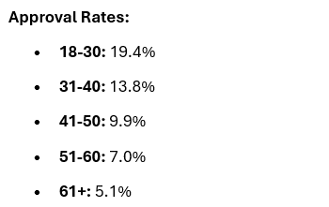
Explore with Visualizations

Slide 7
Objective
To analyze key factors influencing loan approval.
To build a machine learning model that predicts loan approval.
To improve loan approval accuracy and minimize risks.
To ensure fairness and transparency in decision-making.
Target
Banks and Financial Institutions: To improve loan decision-making.
Customers: To receive quick and fair loan approvals.
Fintech Companies: To integrate AI-powered decision systems.

Slide 8

Structure of the Model
Logistic Regression (Baseline model)
Random Forest Classifier (High accuracy & interpretability)
Gradient Boosting (Handles complex relationships)
A web-based loan approval calculator for user interaction.
[6]

Slide 9
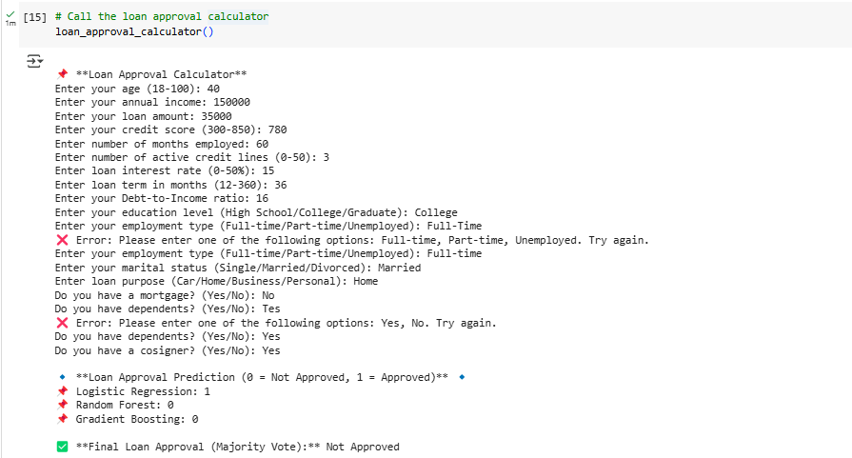

Slide 10
Customer Testimonial
1. Amit K., UK – Experience with AI Lending at Kabbage by American Express
Testimonial: "Traditional banks rejected my loan application, but an AI-powered lender considered my income patterns and granted me a loan at reasonable interest. AI makes lending more inclusive!".[2]
2. JPMorgan Chase – AI-Driven Lending Decisions
Testimonial: "AI-driven credit scoring has allowed us to make fair and unbiased lending decisions, helping more people access credit. The automation has reduced approval time from weeks to minutes.".[3]

Slide 11

Benefits of the System
Faster Loan Processing
Improved Accuracy
Fair and Transparent
Risk Management
Scalability
[7]

Slide 12

1. Segmentation Based on Features:
Age Group
Income Segmentation
Risk Segmentation
[8]
2. Segmented Loan Approval Rates
3. Predictive Segmentation

Slide 13
References
[1] Loan Default Prediction Dataset
[2] https://www.americanexpress.com/en-us/business/blueprint/
[3] https://www.jpmorganchase.com/content/dam/jpmc/jpmorgan-chase-and-co/investor-relations/documents/annualreport-2023.pdf
[4] https://www.alamy.com/stock-photo/loan-approved.html?blackwhite=1&sortBy=relevant
[5] https://www.alamy.com/stock-photo/loan.html?blackwhite=1&sortBy=relevant
[6] https://www.vecteezy.com/vector-art/47588952-coding-logo-sign-outline
[7] https://www.vecteezy.com/vector-art/21839485-benefits-black-glyph-icon-extra-perks-for-employees-profit-sharing-and-insurance-retention-strategy-silhouette-symbol-on-white-space-solid-pictogram-vector-isolated-illustration
[8] https://www.istockphoto.com/vector/conclusion-vector-solid-icon-design-illustration-assessment-symbol-on-white-gm1464783190-497382104

Slide 14
THANK YOU

